Slide 1
BFS Innovations
Cognizant Technology Solutions,
Pune, India
Task 1
VAST 2010

Slide 2
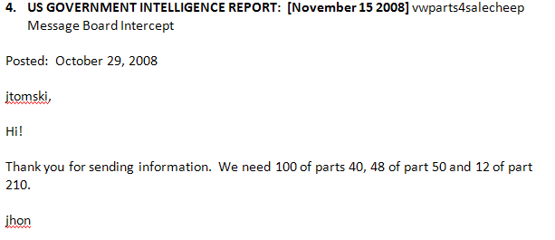

Slide 3
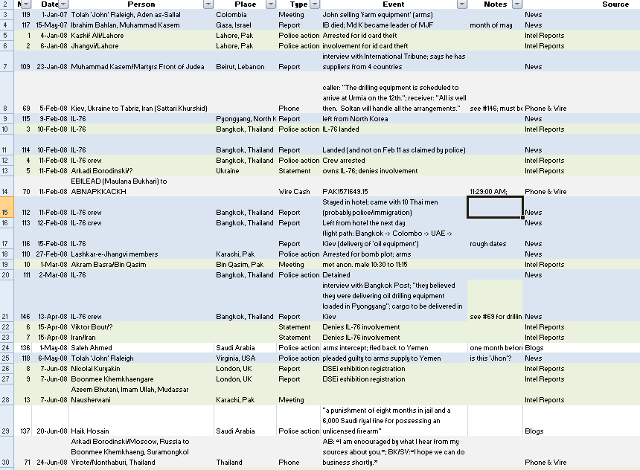

Slide 4
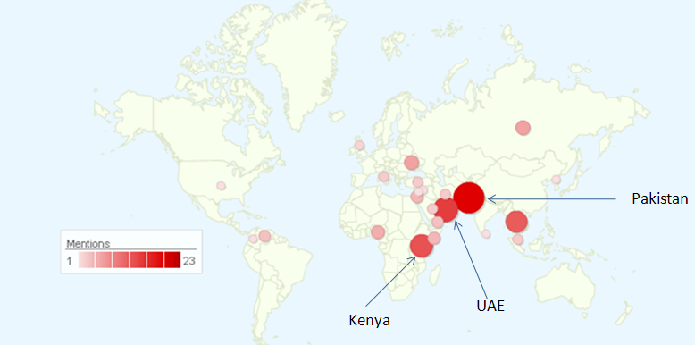

Slide 5
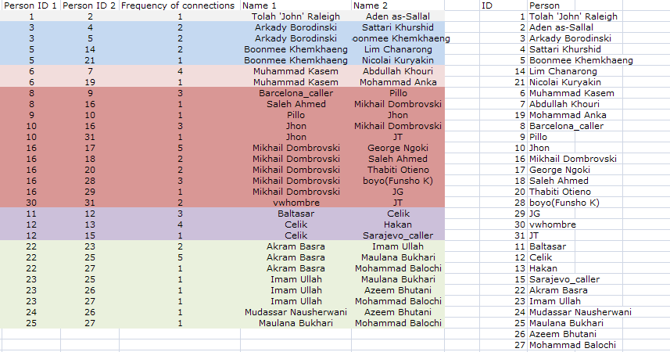

Slide 6
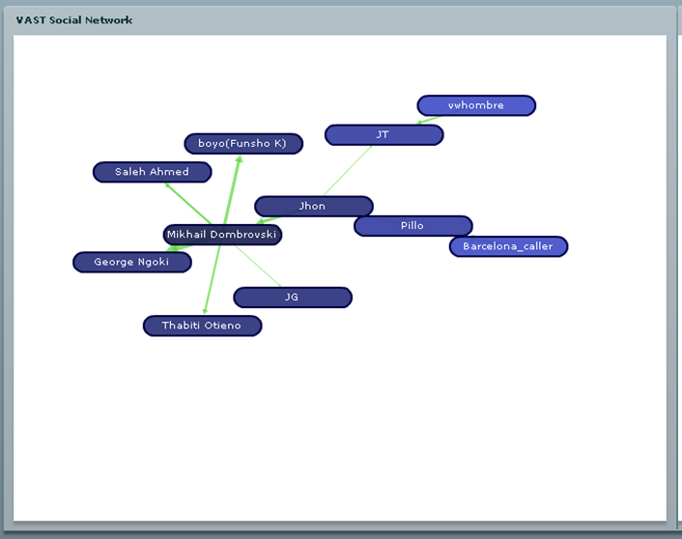

Slide 7
